Slide 1

CLASS 38 CD-404 STATISTICS UNIT 3
STATISTICS
Prof. Vineeta Shrivastava
Assistant Professor
Department of Computer Science & Engineering
LNCT-E, Bhopal
Lakshmi Narain College of Technology Excellence, Bhopal

Slide 2
CLASS 38 CD-404 STATISTICS UNIT 3
AGENDA
Statistical Inferences
Types of statistics
Statistical Variables
Fundamental of descriptive statistics
Prof. Vineeta Shrivastava
Assistant Professor
Department of Computer Science & Engineering
LNCT-E, Bhopal
Lakshmi Narain College of Technology Excellence, Bhopal

Slide 3
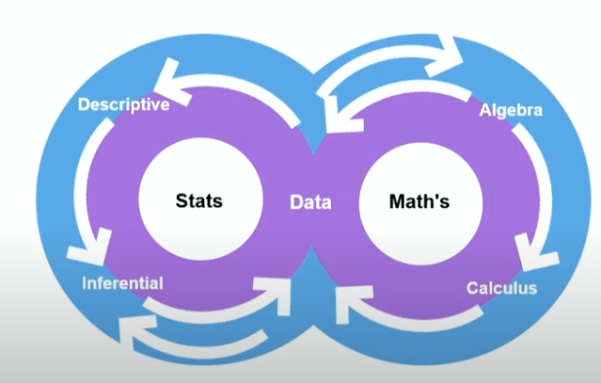
CLASS 38 CD-404 STATISTICS UNIT 3
Statistics and Mathematics Essentials in Data Science:
Data science revolves around these two fields and draws their methods and models to operate on data.
Prof. Vineeta Shrivastava
Assistant Professor
Department of Computer Science & Engineering
LNCT-E, Bhopal
Lakshmi Narain College of Technology Excellence, Bhopal

Slide 4
CLASS 38 CD-404 STATISTICS UNIT 3
Statistics Methods in Data Science
Descriptive statists work on facts about past data.
Inferential statistic works on samples collected from the population to draw conclusions about the population.
Prof. Vineeta Shrivastava
Assistant Professor
Department of Computer Science & Engineering
LNCT-E, Bhopal
Lakshmi Narain College of Technology Excellence, Bhopal

Slide 5
CLASS 38 CD-404 STATISTICS UNIT 3
Mathematical methods in Data Science
Two main methods of mathematics contribute to data science:
Linear algebra is widely used in image recognition ,text analysis and also dimensionality reduction.
Calculus is used in optimization techniques for machine learning.
Prof. Vineeta Shrivastava
Assistant Professor
Department of Computer Science & Engineering
LNCT-E, Bhopal
Lakshmi Narain College of Technology Excellence, Bhopal

Slide 6
CLASS 38 CD-404 STATISTICS UNIT 3
Statistical Inferences
Mathematical Discipline
Including methods of
Data Collection
Data Organization
Data Analysis
Data Interpretation
Data Presentation
Prof. Vineeta Shrivastava
Assistant Professor
Department of Computer Science & Engineering
LNCT-E, Bhopal
Lakshmi Narain College of Technology Excellence, Bhopal

Slide 7
CLASS 38 CD-404 STATISTICS UNIT 3
Example of Statistical Data
Height,Weight,blood Presure,current,voltage
Number of cars , number of children's,Distance,speed, time, pressure
Prof. Vineeta Shrivastava
Assistant Professor
Department of Computer Science & Engineering
LNCT-E, Bhopal
Lakshmi Narain College of Technology Excellence, Bhopal

Slide 8
CLASS 38 CD-404 STATISTICS UNIT 3
Data Collection
Surveys
Census
Sales
Bank Transactions
Online Shopping
Prof. Vineeta Shrivastava
Assistant Professor
Department of Computer Science & Engineering
LNCT-E, Bhopal
Lakshmi Narain College of Technology Excellence, Bhopal

Slide 9
CLASS 38 CD-404 STATISTICS UNIT 3
Data Organization
Data identification, gathering and structuring fro analysis:-
Tumour registry perform
Motor vehicle registration
Voters registration list
List of tax payers
Prof. Vineeta Shrivastava
Assistant Professor
Department of Computer Science & Engineering
LNCT-E, Bhopal
Lakshmi Narain College of Technology Excellence, Bhopal

Slide 10
CLASS 38 CD-404 STATISTICS UNIT 3
Data analysis
Number of patients with a particular cancer type
Number of cars of a particular brand
Number of registered female voters in a constituency
Prof. Vineeta Shrivastava
Assistant Professor
Department of Computer Science & Engineering
LNCT-E, Bhopal
Lakshmi Narain College of Technology Excellence, Bhopal

Slide 11
CLASS 38 CD-404 STATISTICS UNIT 3
Data Interpretation
Demographic of cancer patients
Relation between number of tax paid and number of cars owned.
Female voters turnout in a particular districts.
Urban and rural divide between tax payers.
Prof. Vineeta Shrivastava
Assistant Professor
Department of Computer Science & Engineering
LNCT-E, Bhopal
Lakshmi Narain College of Technology Excellence, Bhopal

Slide 12
CLASS 38 CD-404 STATISTICS UNIT 3
Data presentation
Reports
Charts
Dashboards
Prof. Vineeta Shrivastava
Assistant Professor
Department of Computer Science & Engineering
LNCT-E, Bhopal
Lakshmi Narain College of Technology Excellence, Bhopal

Slide 13
CLASS 38 CD-404 STATISTICS UNIT 3
In general statistics analysis falls into two category
Descriptive Statistics
Inferential Statistics
Prof. Vineeta Shrivastava
Assistant Professor
Department of Computer Science & Engineering
LNCT-E, Bhopal
Lakshmi Narain College of Technology Excellence, Bhopal

Slide 14
CLASS 38 CD-404 STATISTICS UNIT 3
Descriptive statistic
Precisely describes collected data
Report data characteristics
Measure of central tendency
Data spread
Relative standing
Prof. Vineeta Shrivastava
Assistant Professor
Department of Computer Science & Engineering
LNCT-E, Bhopal
Lakshmi Narain College of Technology Excellence, Bhopal

Slide 15
CLASS 38 CD-404 STATISTICS UNIT 3
Characteristics of descriptive analysis
Describes summary of the data
Presents data in meaningful way
Describes already known data
Data tables, charts and dashboards are used
Measures of central tendency, spread of data are the tools of descriptive statistics.
Prof. Vineeta Shrivastava
Assistant Professor
Department of Computer Science & Engineering
LNCT-E, Bhopal
Lakshmi Narain College of Technology Excellence, Bhopal

Slide 16
CLASS 38 CD-404 STATISTICS UNIT 3
Descriptive data examples
Maths score for GCSE students
Collect data for last 3 years
One can quickly compare the results
Number of students with A grade
Number of students with B grade
Number of students with C grade
Number of students Failed
Prof. Vineeta Shrivastava
Assistant Professor
Department of Computer Science & Engineering
LNCT-E, Bhopal
Lakshmi Narain College of Technology Excellence, Bhopal

Slide 17
CLASS 38 CD-404 STATISTICS UNIT 3
Measures of central tendency
Mean
Median
Mode
Prof. Vineeta Shrivastava
Assistant Professor
Department of Computer Science & Engineering
LNCT-E, Bhopal
Lakshmi Narain College of Technology Excellence, Bhopal

Slide 18
CLASS 38 CD-404 STATISTICS UNIT 3
Data Spread
Variance
Standard deviation
Correlation
Covariance
Range
Prof. Vineeta Shrivastava
Assistant Professor
Department of Computer Science & Engineering
LNCT-E, Bhopal
Lakshmi Narain College of Technology Excellence, Bhopal

Slide 19
CLASS 38 CD-404 STATISTICS UNIT 3
Relative Standing
Percentile
Quartile
Inter-Quartile range
Prof. Vineeta Shrivastava
Assistant Professor
Department of Computer Science & Engineering
LNCT-E, Bhopal
Lakshmi Narain College of Technology Excellence, Bhopal

Slide 20
CLASS 38 CD-404 STATISTICS UNIT 3
Inferential Statistics
Draw conclusions about population based on sample data
Generalize from sample to population
Hypothesis testing
Making Predictions
Prof. Vineeta Shrivastava
Assistant Professor
Department of Computer Science & Engineering
LNCT-E, Bhopal
Lakshmi Narain College of Technology Excellence, Bhopal

Slide 21
CLASS 38 CD-404 STATISTICS UNIT 3
Inferential analysis
Analysis of random sample of data taken to describe and make inference about the population.
Inferential statistics compares, test and predict the data.
Make conclusions about the population that is beyond the data available.
Possibility scores are used to represent the data.
Prof. Vineeta Shrivastava
Assistant Professor
Department of Computer Science & Engineering
LNCT-E, Bhopal
Lakshmi Narain College of Technology Excellence, Bhopal

Slide 22
CLASS 38 CD-404 STATISTICS UNIT 3
Inferential Analysis tools
The basic tools for inferential statistics are:
Hypothesis test
Analysis on variance(ANOVA)
Prof. Vineeta Shrivastava
Assistant Professor
Department of Computer Science & Engineering
LNCT-E, Bhopal
Lakshmi Narain College of Technology Excellence, Bhopal

Slide 23
CLASS 38 CD-404 STATISTICS UNIT 3
Inferential data Examples
Suppose you want to know the average height of all the men in a city with a population of so many million residence.
It is not very practical to try and get the height of each man.
Prof. Vineeta Shrivastava
Assistant Professor
Department of Computer Science & Engineering
LNCT-E, Bhopal
Lakshmi Narain College of Technology Excellence, Bhopal

Slide 24
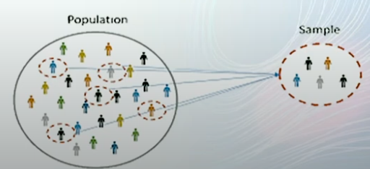
CLASS 38 CD-404 STATISTICS UNIT 3
Population and Sample
Population: Total number of population in a constituency.
Sample: Number of voters selected for opinion pool.
Prof. Vineeta Shrivastava
Assistant Professor
Department of Computer Science & Engineering
LNCT-E, Bhopal
Lakshmi Narain College of Technology Excellence, Bhopal

Slide 25
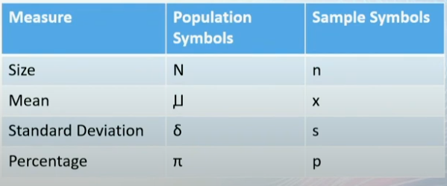
CLASS 38 CD-404 STATISTICS UNIT 3
Sample is a subset of population
Prof. Vineeta Shrivastava
Assistant Professor
Department of Computer Science & Engineering
LNCT-E, Bhopal
Lakshmi Narain College of Technology Excellence, Bhopal

Slide 26
CLASS 38 CD-404 STATISTICS UNIT 3
Statistical Variable
A variable is a data item,characteristics,number or quantity that can be measured or counted.
It is called a variable because value may be vary between data units in a population and may change in value over time.
Prof. Vineeta Shrivastava
Assistant Professor
Department of Computer Science & Engineering
LNCT-E, Bhopal
Lakshmi Narain College of Technology Excellence, Bhopal

Slide 27
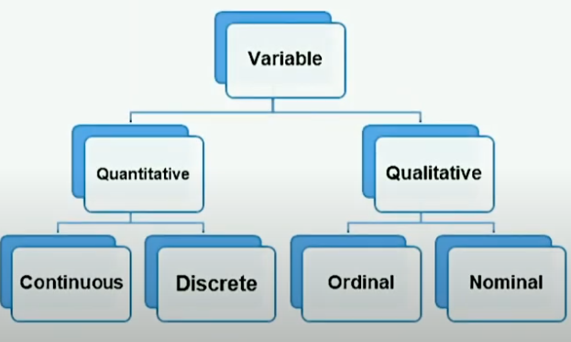
CLASS 38 CD-404 STATISTICS UNIT 3
Statistical Variable
Prof. Vineeta Shrivastava
Assistant Professor
Department of Computer Science & Engineering
LNCT-E, Bhopal
Lakshmi Narain College of Technology Excellence, Bhopal

Slide 28
CLASS 38 CD-404 STATISTICS UNIT 3
Quantitative variables
A variable is quantitative if its value or categories consists of a numbers and if differences between its categories can be expressed numerically.
Examples
Height of an individuals
Age of an individual
Population of a city
Number of square feet in a house.
Number of students in a class.
Prof. Vineeta Shrivastava
Assistant Professor
Department of Computer Science & Engineering
LNCT-E, Bhopal
Lakshmi Narain College of Technology Excellence, Bhopal

Slide 29
CLASS 38 CD-404 STATISTICS UNIT 3
Quantitative Variables
Discrete Variables
A variable whose attributes are separate from one another.
It is a finite number of variables.
Discrete variable scan be measured as Nominal and Ordinal scale
Prof. Vineeta Shrivastava
Assistant Professor
Department of Computer Science & Engineering
LNCT-E, Bhopal
Lakshmi Narain College of Technology Excellence, Bhopal

Slide 30
CLASS 38 CD-404 STATISTICS UNIT 3
Quantitative Variables
Continuous Variables
A variable can be on any value between two specified values.
It is an infinite number of values.
Continuous variables is also known as Quantitative Variables.
Continuous variables are measured as interval and ratio scale.
Prof. Vineeta Shrivastava
Assistant Professor
Department of Computer Science & Engineering
LNCT-E, Bhopal
Lakshmi Narain College of Technology Excellence, Bhopal

Slide 31
CLASS 38 CD-404 STATISTICS UNIT 3
Qualitative Variables
Qualitative variable shave discrete categories, usually designed by words, label and non numeric differences between categories.
Gender
Breed of dogs
Level of education
Eye coloue
Prof. Vineeta Shrivastava
Assistant Professor
Department of Computer Science & Engineering
LNCT-E, Bhopal
Lakshmi Narain College of Technology Excellence, Bhopal

Slide 32
CLASS 38 CD-404 STATISTICS UNIT 3
Qualitative Variables
Ordinal Variable
Ordinal data is a categorical, statistical data type where the variables have natural, ordered categories and the distance between categories are unknown.
Prof. Vineeta Shrivastava
Assistant Professor
Department of Computer Science & Engineering
LNCT-E, Bhopal
Lakshmi Narain College of Technology Excellence, Bhopal

Slide 33
CLASS 38 CD-404 STATISTICS UNIT 3
Ordinal variables example
Ordinal data are categorical, statistical data type where the variables have natural, ordered categories and the distances between the categories are not known.
Prof. Vineeta Shrivastava
Assistant Professor
Department of Computer Science & Engineering
LNCT-E, Bhopal
Lakshmi Narain College of Technology Excellence, Bhopal

Slide 34
CLASS 38 CD-404 STATISTICS UNIT 3
Ordinal Variable example
Customer satisfaction level
Happy
Satisfy
Some what satisfied
Not satisfied
Unhappy
Prof. Vineeta Shrivastava
Assistant Professor
Department of Computer Science & Engineering
LNCT-E, Bhopal
Lakshmi Narain College of Technology Excellence, Bhopal

Slide 35
CLASS 38 CD-404 STATISTICS UNIT 3
Ordinal Variable examples
Frequency of going to gym
Never
Rarely
Sometimes
Often
Regular
Prof. Vineeta Shrivastava
Assistant Professor
Department of Computer Science & Engineering
LNCT-E, Bhopal
Lakshmi Narain College of Technology Excellence, Bhopal

Slide 36
CLASS 38 CD-404 STATISTICS UNIT 3
Nominal Variable
A nominal scale describes a variable with categories that don't have a natural order or ranking.
We can code nominal variables with numbers if you want, but the order is arbitrary and any calculations such as computing a mean, median or standard deviation would be meaningless.
Prof. Vineeta Shrivastava
Assistant Professor
Department of Computer Science & Engineering
LNCT-E, Bhopal
Lakshmi Narain College of Technology Excellence, Bhopal

Slide 37
CLASS 38 CD-404 STATISTICS UNIT 3
Nominal Variables examples
Gender
Race
Eye colour
Language
Material status
Prof. Vineeta Shrivastava
Assistant Professor
Department of Computer Science & Engineering
LNCT-E, Bhopal
Lakshmi Narain College of Technology Excellence, Bhopal

Slide 38
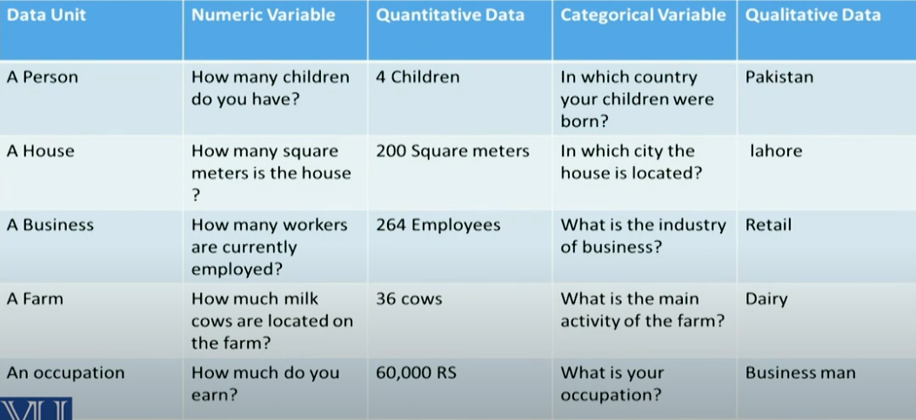
CLASS 38 CD-404 STATISTICS UNIT 3
Comparison
Prof. Vineeta Shrivastava
Assistant Professor
Department of Computer Science & Engineering
LNCT-E, Bhopal
Lakshmi Narain College of Technology Excellence, Bhopal

Slide 39
CLASS 38 CD-404 STATISTICS UNIT 3
Fundamental of descriptive statistics
To organize, summarize and simplify, describe and present the data in a meaningful manner.
Following are the three main description classifications:
Measures of central tendency
Spread of data
Relative standing of data
Prof. Vineeta Shrivastava
Assistant Professor
Department of Computer Science & Engineering
LNCT-E, Bhopal
Lakshmi Narain College of Technology Excellence, Bhopal

Slide 40
CLASS 38 CD-404 STATISTICS UNIT 3
Mean
In mathematics and statistics, the arithmetic mean or simply the mean or the average, is the sum of collection of numbers divided by the count of number in the collection.
The collection is often a set of results of an experiments or an observational study, or frequently a set of results from a survey.
Prof. Vineeta Shrivastava
Assistant Professor
Department of Computer Science & Engineering
LNCT-E, Bhopal
Lakshmi Narain College of Technology Excellence, Bhopal

Slide 41
CLASS 38 CD-404 STATISTICS UNIT 3
Median
In statistics and probability theory, the median is the value separating the higher half from the lower half of a data sample, a population or a probability distribution.
For a data set , it may be thought of as the “MID” value.
Prof. Vineeta Shrivastava
Assistant Professor
Department of Computer Science & Engineering
LNCT-E, Bhopal
Lakshmi Narain College of Technology Excellence, Bhopal

Slide 42
CLASS 38 CD-404 STATISTICS UNIT 3
Mode
The mode is the value that appears most often in a set of data values.
If X is a discrete random variable, the mode is the value x at which the probability mass function takes its maximum value.
In other words it is the value that is most likely to be sampled.
Prof. Vineeta Shrivastava
Assistant Professor
Department of Computer Science & Engineering
LNCT-E, Bhopal
Lakshmi Narain College of Technology Excellence, Bhopal

Slide 43
CLASS 38 CD-404 STATISTICS UNIT 3
Spread of Data
Standard Deviation
Variance
Covariance
Correlation
Range
Prof. Vineeta Shrivastava
Assistant Professor
Department of Computer Science & Engineering
LNCT-E, Bhopal
Lakshmi Narain College of Technology Excellence, Bhopal

Slide 44
CLASS 38 CD-404 STATISTICS UNIT 3
Standard Deviation
In statistics the standard deviation is the measure of the amount of variation or dispersion of a set of values.
A low standard deviation indicates that the values tend to be close to the mean of a set, while a high standard deviation indicates that the values are spread out over a wider range.
Prof. Vineeta Shrivastava
Assistant Professor
Department of Computer Science & Engineering
LNCT-E, Bhopal
Lakshmi Narain College of Technology Excellence, Bhopal

Slide 45
CLASS 38 CD-404 STATISTICS UNIT 3
Variance
In probability theory and statistics, variance is the expectation of the squared deviation of a random variable from its population mean or sample mean.
Variance is a measure of dispersion, meaning it is a measure of how far a set of numbers is spread out from their average value.
Prof. Vineeta Shrivastava
Assistant Professor
Department of Computer Science & Engineering
LNCT-E, Bhopal
Lakshmi Narain College of Technology Excellence, Bhopal

Slide 46
CLASS 38 CD-404 STATISTICS UNIT 3
Covariance
In probability theory and statistics, covariance is a measure of the joint variability of two random variables.
If the greater values of one variable mainly correspond with a greater values of the other variable, and the same holds for the lesser values, the covariance is positive.
Prof. Vineeta Shrivastava
Assistant Professor
Department of Computer Science & Engineering
LNCT-E, Bhopal
Lakshmi Narain College of Technology Excellence, Bhopal

Slide 47
CLASS 38 CD-404 STATISTICS UNIT 3
Correlation
In statistics, correlation or dependence is any statistical relationship, weather casual or not, between two random variables or bivariate data.
In the broadest sense correlation is any statistical association, through it actually refers to the degree to which a pair of variables are linearly related.
Prof. Vineeta Shrivastava
Assistant Professor
Department of Computer Science & Engineering
LNCT-E, Bhopal
Lakshmi Narain College of Technology Excellence, Bhopal

Slide 48
CLASS 38 CD-404 STATISTICS UNIT 3
Range
In statistics the range of a set of data is the difference between the largest and smallest value.
Difference here is specific, the range of a set of data is the result of subtracting the ample maximum and minimum.
However in descriptive statistics, this concept of range has a more complex meaning.
Prof. Vineeta Shrivastava
Assistant Professor
Department of Computer Science & Engineering
LNCT-E, Bhopal
Lakshmi Narain College of Technology Excellence, Bhopal

Slide 49
CLASS 38 CD-404 STATISTICS UNIT 3
Relative standing of data
Measure of relative standing , in the statistical sense can be defined as measures that can be used to compare values from different data sets, or compare values within the same dataset.
Percentile
Quartile
Inter-quartile range
Prof. Vineeta Shrivastava
Assistant Professor
Department of Computer Science & Engineering
LNCT-E, Bhopal
Lakshmi Narain College of Technology Excellence, Bhopal

Slide 50
CLASS 38 CD-404 STATISTICS UNIT 3
Percentile
In statistics , a k-th percentile, is a score below which a given percentage k of scores in its frequency distribution falls or a score at or below which a given percentage fall.
For examples, the 50th percentile is the score below which or at or below which 50% of the score in the distribution may found.
Prof. Vineeta Shrivastava
Assistant Professor
Department of Computer Science & Engineering
LNCT-E, Bhopal
Lakshmi Narain College of Technology Excellence, Bhopal

Slide 51
CLASS 38 CD-404 STATISTICS UNIT 3
Quartile
A quartile is a statistical term that describes a division of observations into four defined intervals based on the values of the data and how they compare to the entire set of observation.
Prof. Vineeta Shrivastava
Assistant Professor
Department of Computer Science & Engineering
LNCT-E, Bhopal
Lakshmi Narain College of Technology Excellence, Bhopal

Slide 52
CLASS 38 CD-404 STATISTICS UNIT 3
Inter-quartile range
The interquartile range defines the difference between the third and the first quartile. Quartiles are the partitioned values that divide the whole series into 4 equal parts. So, there are 3 quartiles.
First Quartile is denoted by Q1 known as the lower quartile, the second Quartile is denoted by Q2 and the third Quartile is denoted by Q3 known as the upper quartile.
Therefore, the interquartile range is equal to the upper quartile minus lower quartile.
Prof. Vineeta Shrivastava
Assistant Professor
Department of Computer Science & Engineering
LNCT-E, Bhopal
Lakshmi Narain College of Technology Excellence, Bhopal

Slide 53
CLASS 38 CD-404 STATISTICS UNIT 3
THANKYOU
Prof. Vineeta Shrivastava
Assistant Professor
Department of Computer Science & Engineering
LNCT-E, Bhopal
Lakshmi Narain College of Technology Excellence, Bhopal

